Slide 1
RUNGTA COLLEGE OF DENTAL SCIENCES & RESEARCH
TITLE OF THE TOPIC-
GROWTH & DEVELOPMENT - GENERAL PRINCIPLE AND CONCEPT
DEPARTMENT OF ORTHODONTICS AND DENTOFACIAL ORTHOPAEDICS

Slide 2
Specific learning Objectives
CORE AREAS | DOMAIN | CATEGORY
GROWTH & DEVELOPMENT DEFINITIONS | AFFECTIVE | DESIRE TO KNOW
SCAMMON’S GROWTH CURVE | COGNITIVE | MUST KNOW
CEPHALO-CAUDAL GROWTH GRADIENT | COGNITIVE | MUST KNOW
METHODS OF STUDYING GROWTH | PSYCHOMOTOR | MUST KNOW
BONE DEPOSITION & RESORPTION | COGNITIVE | NICE TO KNOW
ENDOCHONDRAL BONE FORMATION | COGNITIVE | NICE TO KNOW
INTRAMEBRANOUS BONE FORMATION | AFFECTIVE | NICE TO KNOW
FUNCTIONAL MATRIX | COGNITIVE | MUST KNOW
ENLOWS EXPANDING V PRINCIPLE | COGNITIVE | MUST KNOW

Slide 3
CONTENTS
PART I
GROWTH & DEVELOPMENT DEFINITIONS
SCAMMON’S GROWTH CURVE
CEPHALO-CAUDAL GROWTH GRADIENT
METHODS OF STUDYING GROWTH
BONE DEPOSITION & RESORPTION
ENDOCHONDRAL BONE FORMATION
INTRAMEBRANOUS BONE FORMATION

Slide 4
GROWTH
DEFINITION
- “The self multiplication of living substance”(J.S. Huxley)
- “Increase in size , change in proportion and progressive complexity”(Krogman)
- “An increase in size”(Todd)

Slide 5
DEVELOPMENT
DEFINITION-
- “Progress towards maturity”- TODD
- “ Development refers to all the naturally occurring unidirectional changes in the life of an individual from its existence as a single cell to its elaboration as a multifunctional unit terminating in death”- Moyers

Slide 6
GROWTH SPURTS
Growth doesn’t takes place uniform at all times.
There seems to be some stage when sudden acceleration in growth takes place.
This sudden increase in growth is termed as “growth spurt”.

Slide 7
TIMINGS OF GROWTH SPURT
Just before birth
One year after birth
Mixed dentition growth spurt
Boys: 8-11 years
Girls: 7-9 years
Pre-pubertal growth spurt
Boys: 14-16 years
Girls: 11-13 years

Slide 8
DIFFERENTIAL GROWTH
Different organs grow at different rates and at different times. This is termed as differential growth.
The rate of growth can be best described by:
-SCAMMON’S CURVE OF GROWTH
-CEPHALO-CAUDAL GRADIENT OF GROWTH

Slide 9
SCAMMON’S CURVE OF GROWTH
Body tissues are broadly classified into 4 types:
Lymphoid Tissues
Neural Tissues
General Tissues
Genital tissues

Slide 10
LYMPHOID TISSUE
- Lymphoid tissues proliferate rapidly in late childhood and reaches almost 200% of adult size.
- This is an adaptation to protect children from infection, as they are more prone to it.
- By about 18 years of age lymphoid tissues undergo involution to reach adult size.

Slide 11
NEURAL TISSUE
- Grows very rapidly and almost reaches adult size by 6-7 years of age.
- Very little growth is seen after 6-7 years

Slide 12
GENERAL TISSUE
General or visceral tissues consist of muscles, bones and other organs.
“S” shaped curve with rapid growth up to 2-3 years of age followed by a slow phase of growth between 3-10 years.
After the 10th year rapid phase of growth occurs terminating by 18-20th year.

Slide 13
GENITAL TISSUE
Consist of reproductive organs.
Shows negligible growth until puberty.
They grow rapidly at puberty reaching adult size after which growth ceases.

Slide 14
SCAMMON’S GROWTH CURVE

Slide 15
CEPHALO-CAUDAL GRADIENT OF GROWTH
Head takes upto 50% of total body length around 3rd month of intrauterine life.
At the time of birth head size reduces to 30% of body length.
As age increases there is a progressive reduction to the relative size of head to about 12% in the adult
Lower limbs are rudimentary around 2nd month of IU life. They later grow and represent almost 50% of body length at adulthood.
Post-natally the face grows more than cranium.

Slide 17
METHODS OF STUDYING GROWTH
Measurement approaches
Experimental approaches
Bimetric Test- Weight, height, skeletal maturation and ossification are measured according to standard basis.
Vital Staining- Site of growth, direction, duration, amount of growth at different sites are measured.
Radioisotopes- Incorporated in bone works as in vivo markers.

Slide 18
RADIOGRAPHIC TECHNIQUE
Cephalometry- Helps to take serial radiographs of patients skull to measure the growth changes taking place.
Hand-wrist X-rays- Hand wrist radiographs help to study the biological or skeletal age of a person. The carpels have specific age of ossification.

Slide 19
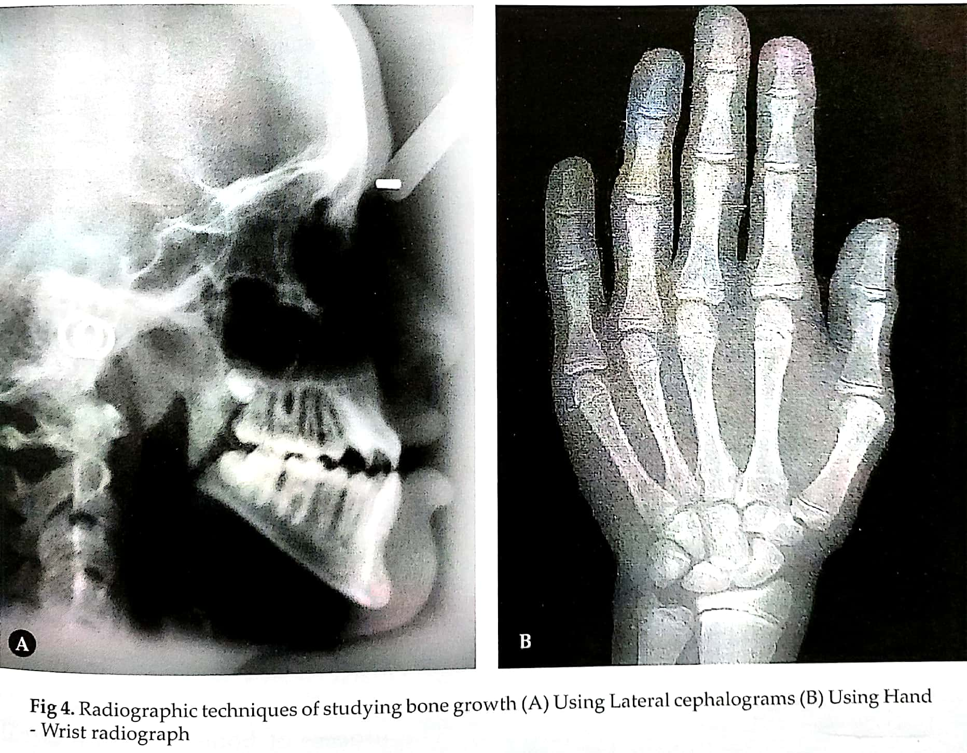

Slide 20
BONE DEPOSITION AND RESORPTION
Bony changes takes place by bone deposition and resorption known as bone remodelling.
Changes that are produced are:
Change in size
Chang in shape
Change in proportion
Change in relationship of the bone with adjacent structures.

Slide 21
CORTICAL DRIFT
Combination of bone deposition and resorption resulting in a growth movement towards the depositing surface is called cortical drift.
If deposition and resorption on either side is same then the bone remains constant.
If less bone is resorbed and more bone is deposited then thickness of the bone increases.

Slide 22
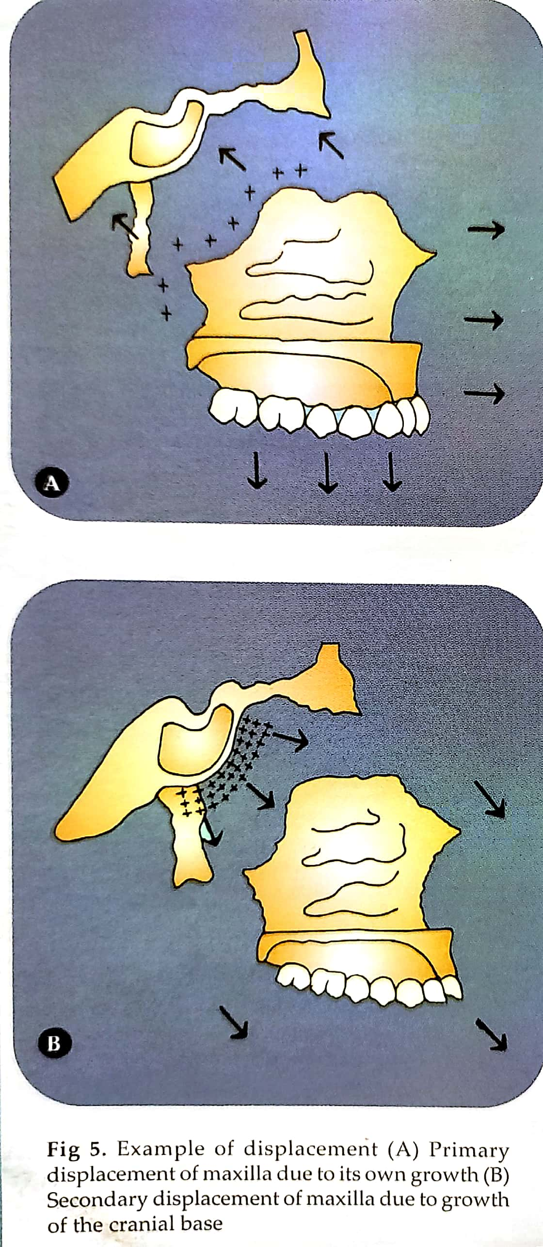

Slide 23
DISPLACEMENT
Primary Displacement- If a bone is displaced as a result of its own growth, it is called primary displacement.
For example- Growth of maxilla at the tuberosity region results in pushing the maxilla to the cranial base.

Slide 24
Secondary Displacement- If a bone is displaced due to growth and enlargement of adjacent bone, it is called secondary displacement.
For example- The growth of cranial base causes the forward and downward displacement of maxilla.

Slide 25
OSTEOGENESIS
Process of bone formation is called osteogenensis.
2 ways of bone formation takes place:-
Endochondral bone formation
Intra membranous bone formation.

Slide 26
ENDOCHONDRAL BONE FORMATION
Mesenchymal cells become condensed at the site of bone formation.
These cells differentiate into chondroblasts and lay down hyaline cartilage.
Cartilage is surrounded by perichondrium that is highly vascular.
The intercellular substance becomes calcified due to influence of alkaline phosphatase.

Slide 27
Thus the cartilage nutrition is cut off leading to their death and space is created called as primary areolae.
Blood vessels and osteogenic cells invade the calcified cartilagineous matrix. This forms secondary areolae.
Osteogenic cells from perichondrium becomes osteoblast.
The osteoblast lay down layers of osteoid and helps in bone formation.

Slide 29
INTRA-MEMBRANOUS BONE FORMATION
At the site of bone formation mesenchymal cells become aggregated.
Some mesenchymal cells lay down bundle of collagen fibres.
Some mesenchymal cells enlarge and form osteoblasts.
These osteoblasts secrete a gelatinous matrix called osteoid and calcium salt is deposited converting osteoid into bony lamellae.
Osteoblasts move away from lamellae and new layer of osteoid is secreted. The trapped osteoblasts form osteocytes.

Slide 30
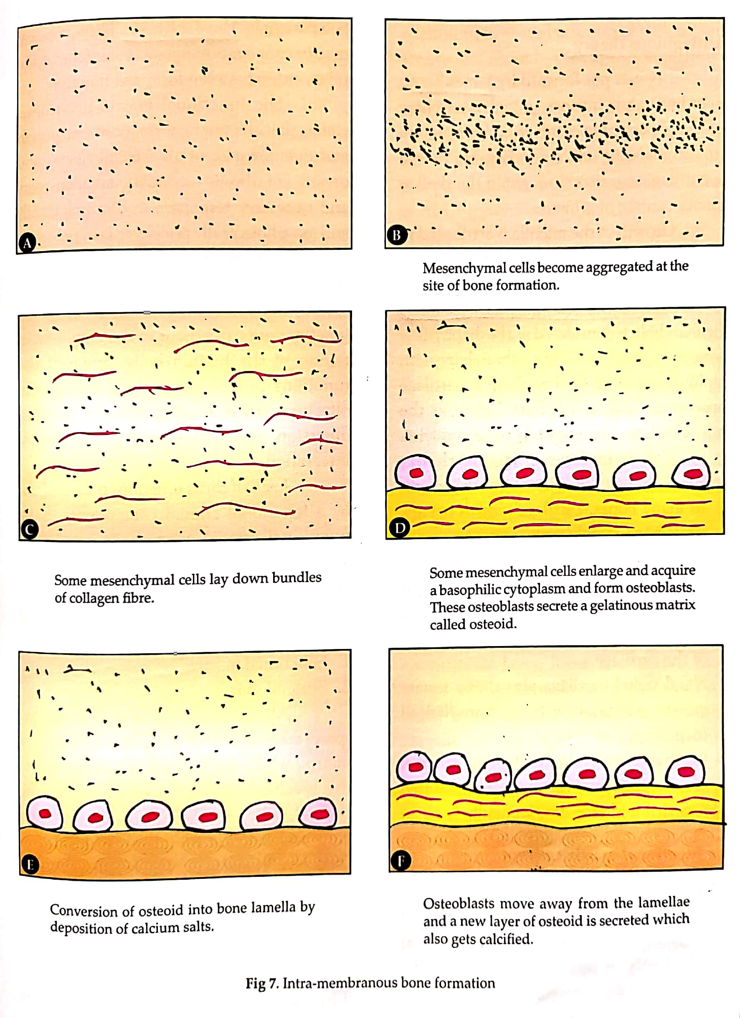

Slide 31
SKELETAL UNIT
1) All skeletal tissues associated with single function are called skeletal unit.
2) Discrete skeletal units are termed as “Micro-skeletal unit”.
3) The maxilla( orbit, pneumatic, palatal and basal micro-skeletal units) and mandible( alveolar, angular, condylar, gonial, mental, coronoid and basal micro-skeletal units) are comprised of such micro skeletal units comprising together as “Macro-skeletal unit”.

Slide 33
SUMMARY
Growth is quantitative
Growth might cause change in form or proportion, increase or decrease in size, and change in texture and complexity. In simple words, growth is change or difference in quantity
Characteristically, growth is equated with enlargement. But sometimes there are instances in which there is a decrease in size during growth, e.g. thymus gland after puberty.
Development includes all the changes in the life of a subject from his or her origin as a single cell till death.
It comprises sequential events from fertilization till death.
Development: growth + differentiation + translocation where differentiation means change in quality and translocation means change in position

Slide 34
REFERENCES
Textbook of Orthodontics – Gurkeerat Singh, Jaypee Brothers; 2nd Edition
Orthodontics – The Art and Science, S.I Bhalajhi, AryaMedi Publishing; 7th Edition
Textbook of Orthodontics – Sridhar Premkumar, Elsevier; 1st Edition
Orthodontics: Diagnosis and Management of Malocclusion and Dentofacial Deformities – O.P Kharbanda, Elsevier; 1st Edition

Slide 35
Question & Answer Session

